Slide 1

NBA TEAM PERFORMANCE ANALYSIS
ASDS-6301 — Advanced Regression
· Phuong Trinh
· Sashi Kumar Soni
· Ahmet Toure

Slide 2
Background
NBA scheduling creates fatigue: long travel, back-to-back games, uneven rest.
Goal: quantify how rest days, travel distance, and schedule density affect performance.
Important for sports analytics: fairness, load management, strategy.

Slide 3

Research Question
How do travel distance and rest days affect Win% and efficiency?
Do back-to-back games reduce performance?
How does home-court advantage interact with fatigue?
Which regression model best explains win probability?
(Multiple Linear, Ridge, Lasso, Mixed-Effects)

Slide 4
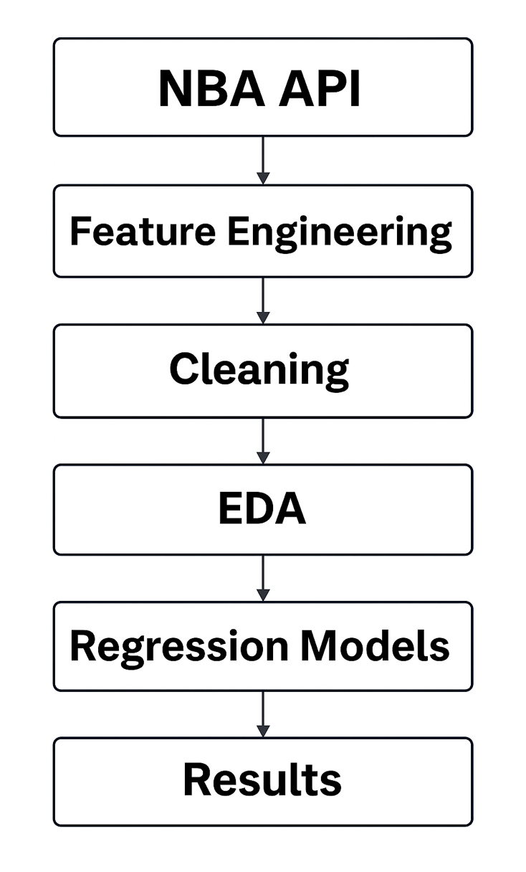
Data Overview
Python (NBA API → CSV) → R (Cleaning, EDA, Modeling)
Team game logs (2023–2025 seasons).
Derived variables: Rest_Days, Back_to_Back, Travel_Distance.
Final dataset: 4,920 games × 41 variables.

Slide 5
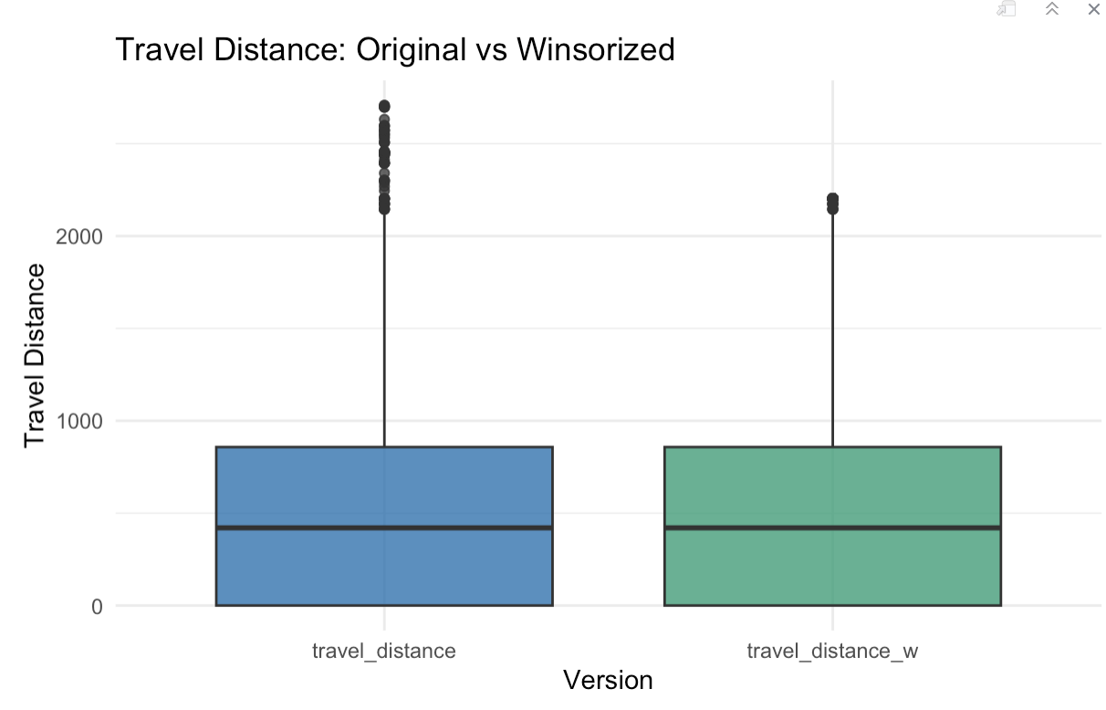
Data Preprocessing
Handled missing values for travel + previous location.
Removed 0 duplicates.
Outlier was detected using IQR, handling using Winsorization.
Normalizing and Scaling Data

Slide 6
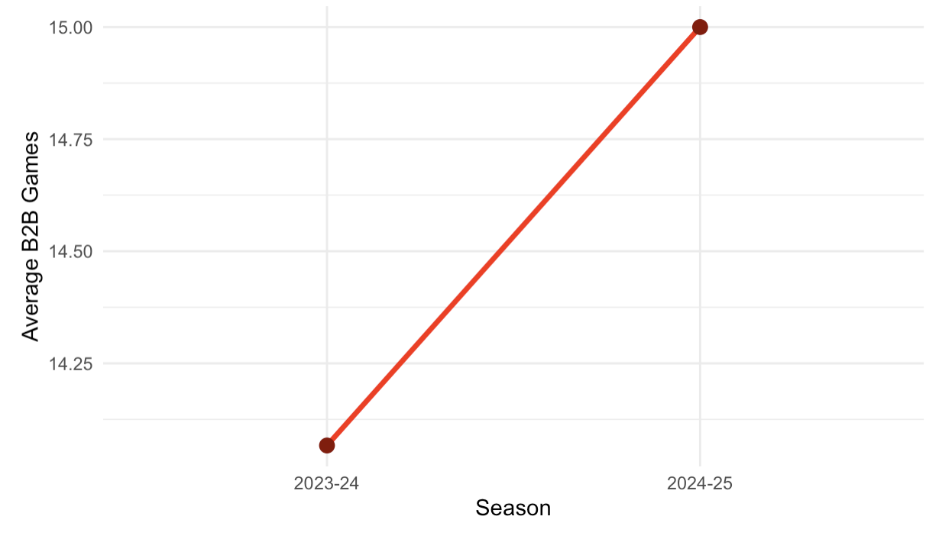
Exploratory Data Analysis
Back-to-Back Trends
Notes:
Average B2B games slightly changed between 2023–24 and 2024–25.
Teams vary significantly in total B2B load.

Slide 7
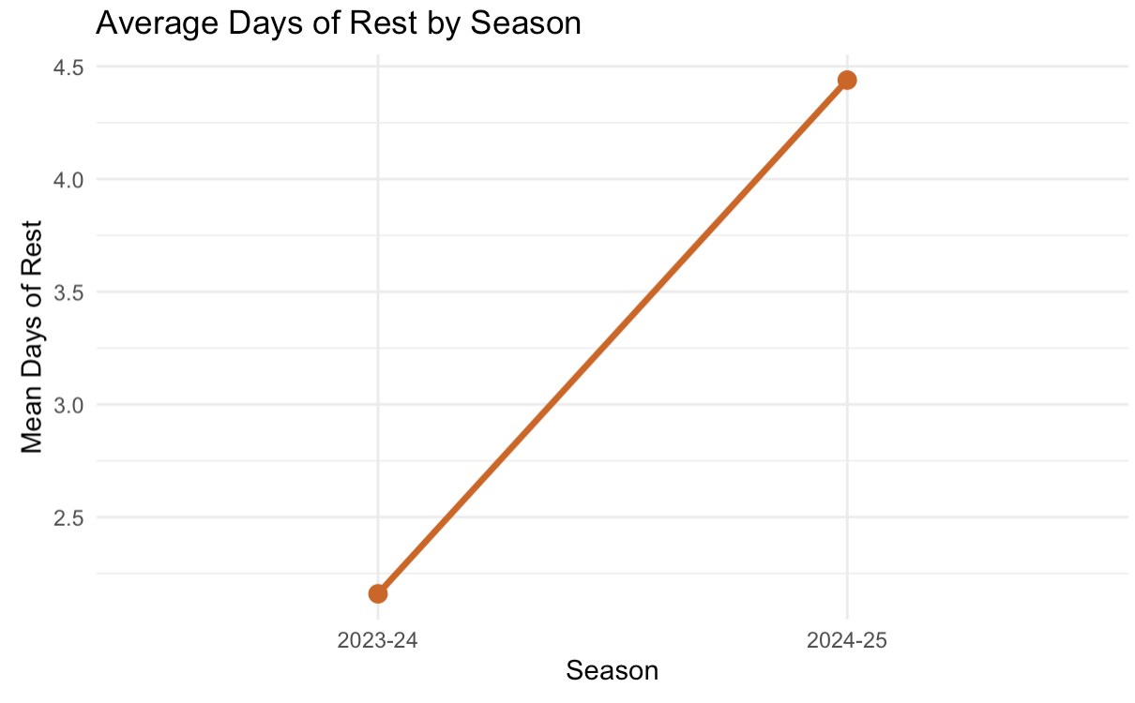
Exploratory Data Analysis
Rest Distribution
Notes:
Mean rest days ~2–3
Some teams averaged higher rest

Slide 8
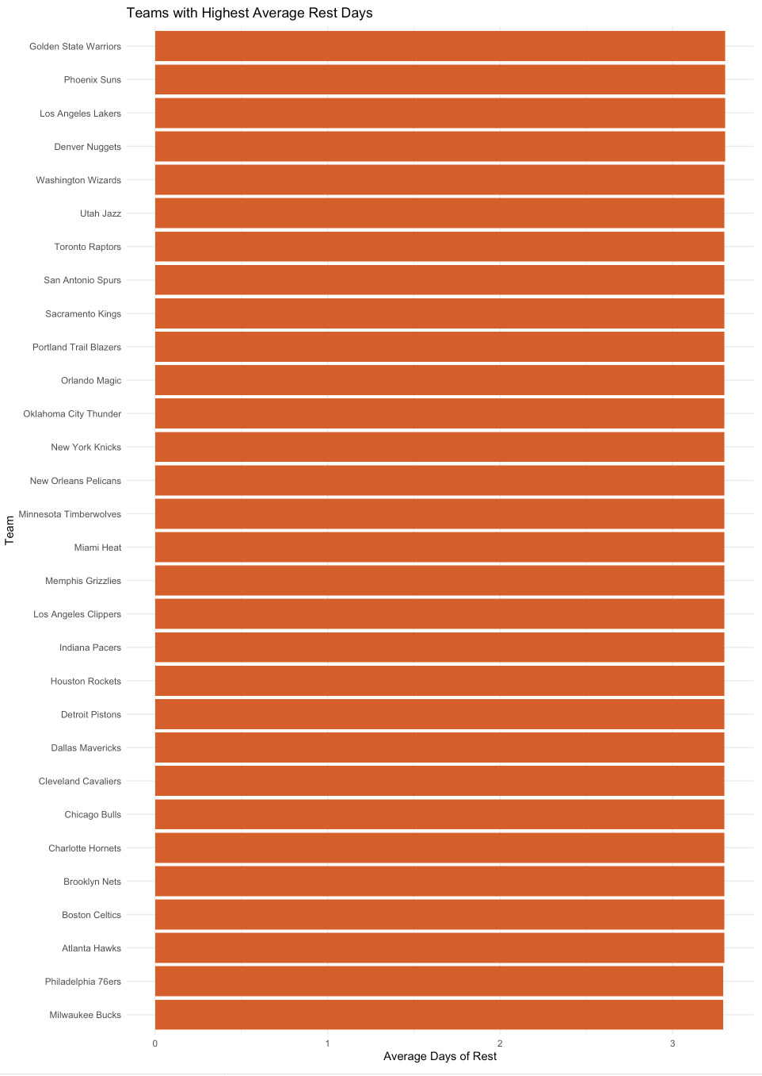
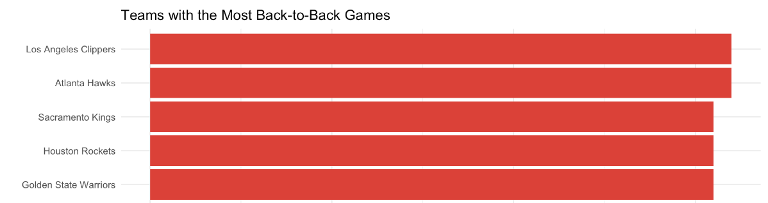
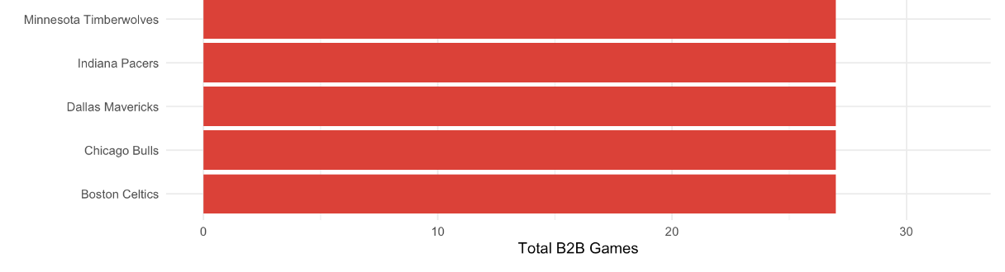
EDA

Slide 9
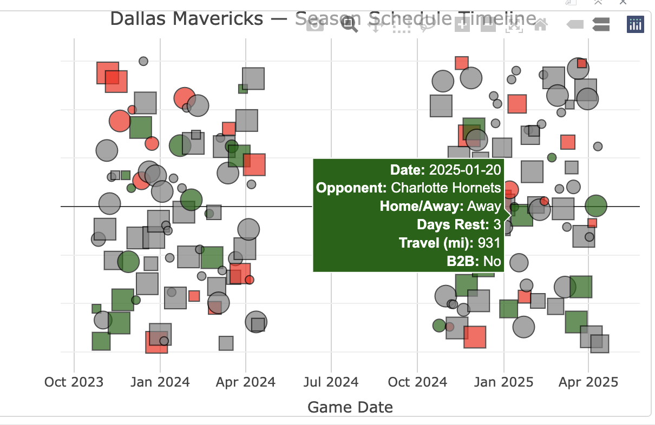
EDA
Dallas Mavericks - Season Schedule Timeline
Using plotly (interactive full-season schedule viewer)

Slide 10
Key Variables
Schedule Factors:
  Travel Distance
  Rest Days
  Back-to-Back indicator
  Home / Away
  Opponent Strength
Performance Metrics:
  FG%, FG3%, FT%
  AST, REB, TOV
  +/−, Points
  Win (binary target)

Slide 11
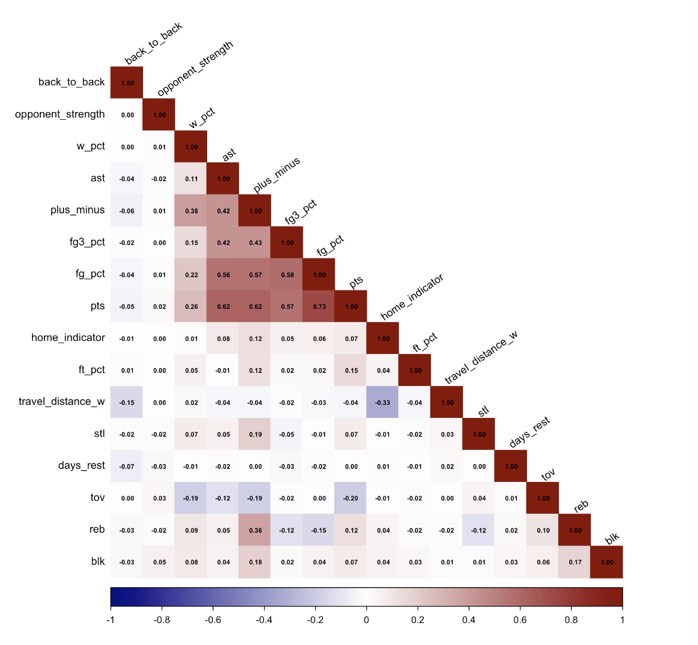
Correlation Heatmap

Slide 12
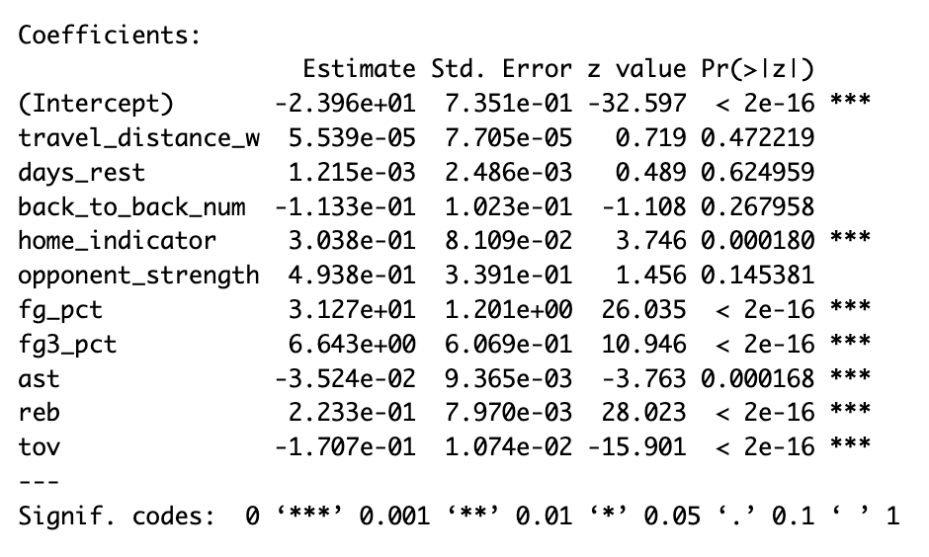
Logistic Regression
Performance metrics (FG%, FG3%, REB, TOV) dominate → scheduling variables become insignificant
Suggests logistic regression alone cannot generalize well
Notes:
Why Overfitting Occurred
Too many correlated predictors
Very strong performance stats overpower schedule factors
Residual diagnostics confirm unrealistic fit (as seen in Q-Q plot & fitted residuals)

Slide 13
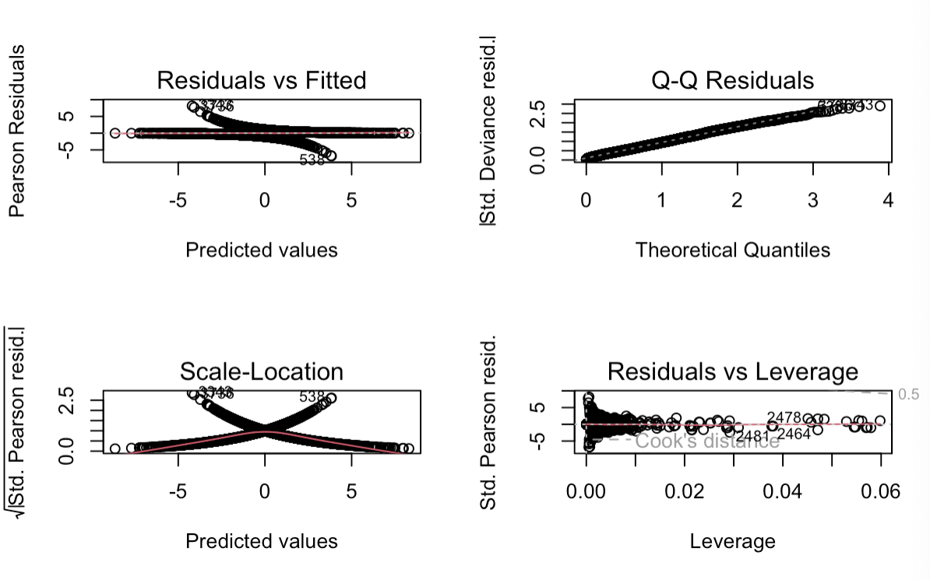
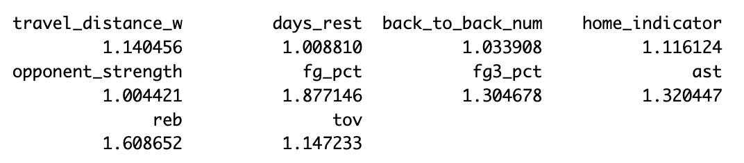
Diagnostic Plots and VIF Check
Diagnostic Plot Interpretation
Q–Q Plot: Deviations from diagonal → non-normal residuals
VIF Check
All VIF values < 2, meaning no severe multicollinearity
Overfitting is NOT due to multicollinearity → caused by model complexity & strong predictors

Slide 14
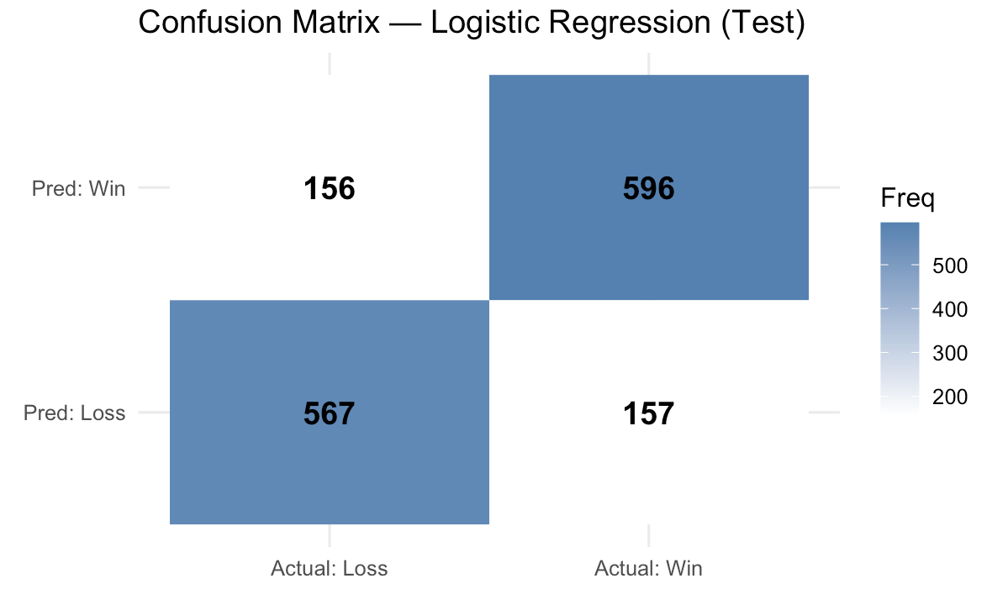
Confusion Matrix
Accuracy: 0.7879404
Sensitivity: 0.7915007
Specificity: 0.7842
Notes:
Sensitivity : 0.7915
Specificity : 0.7842
Pos Pred Value : 0.7926
Neg Pred Value : 0.7831
Prevalence : 0.5102
Detection Rate : 0.4038
Detection Prevalence : 0.5095
Balanced Accuracy : 0.7879

Slide 15
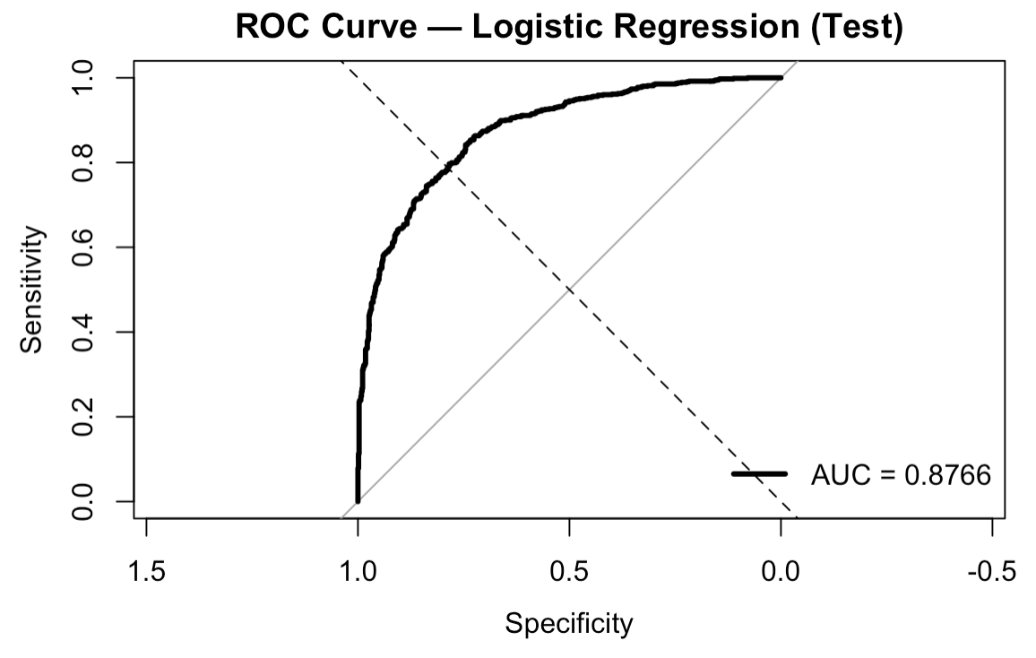
ROC-Curves

Slide 16

Why We Used Ridge & Lasso
  Checked if Logistic regression is overfitting
  Many correlated performance predictors (FG%, FG3%, REB, TOV)
  Strong box-score stats overpowered schedule-related variables
  Diagnostic plots confirmed poor generalization
  Diagnostic plots suggests to try regularization, tree based models (RF/XGBoost)

Slide 17
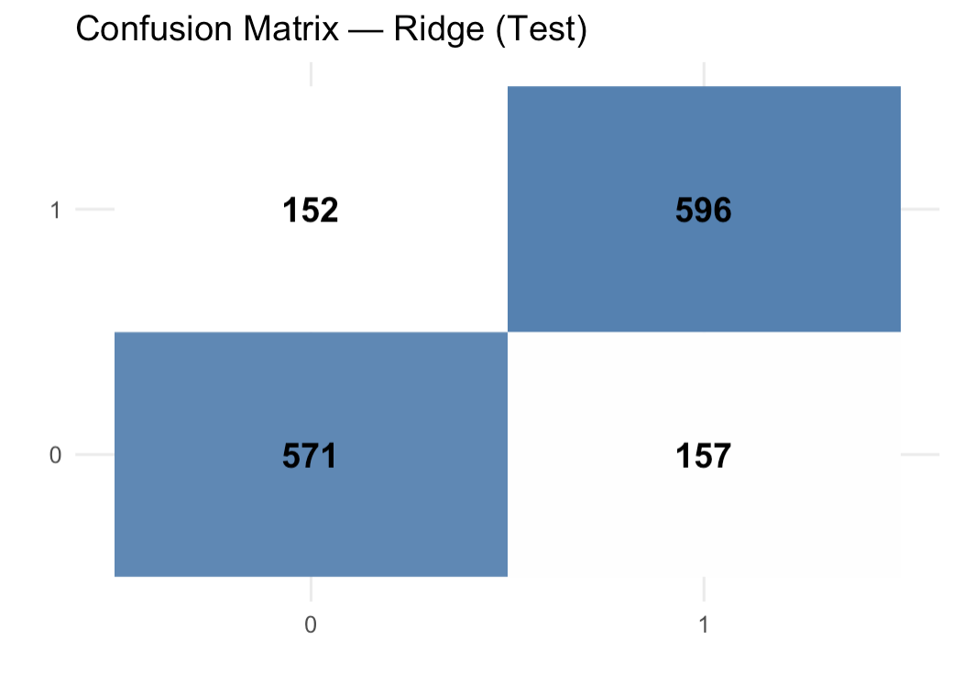
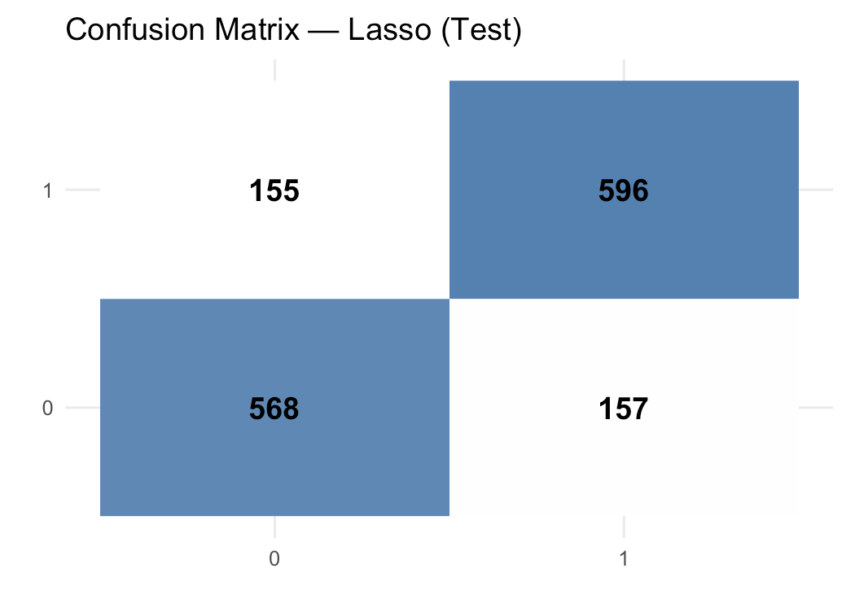
Ridge vs Lasso

Slide 18
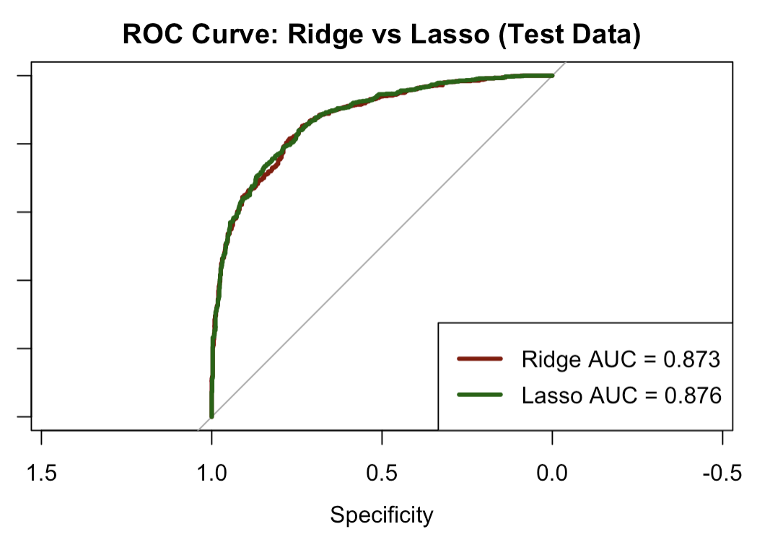
Ridge vs Lasso
Model Performance
  Ridge Accuracy = 0.790
  Lasso Accuracy = 0.788
Notes:
Ridge and Lasso reduce overfitting by shrinking coefficients
Lasso simplifies the model by forcing weaker predictors toward zero
Both models identify shooting efficiency & rebounding as dominant predictors
Regularization creates a more stable and generalizable win probability model

Slide 19
Results
Shooting efficiency (FG%, FG3%) and rebounding are the strongest predictors of winning.
Home games increase win probability.
Fatigue variables (travel, rest, B2B) have smaller effects than expected once performance stats are included.
Ridge/Lasso handle multicollinearity and improve predictive accuracy.

Slide 20

Limitations
Opponent strength metric is simplistic (lagged win% only).
Player-level fatigue/load not available.
Travel distances assume great-circle distance (not actual flight route).
Multiseason effects may require mixed models.

Slide 21

Conclusion
Travel and rest matter, but basketball performance metrics has a strongest impact on predicting wins.
Ridge/Lasso produce stable, high-accuracy models work well with high correlated variables
Framework can support NBA scheduling research and competitive fairness analysis.
Notes:
Overall, this framework can be useful for future NBA scheduling research and fairness evaluations, because it connects game performance with the actual conditions teams face

Slide 22
Future Work
Expand dataset to include more seasons for stronger long-term patterns.
Add player-level fatigue metrics (minutes, usage rate, injuries).
Incorporate travel direction & time-zone shifts as extra fatigue factors.
Test advanced models (Random Forest, XGBoost, Mixed-Effects refinements).
Build a fairness index to compare schedule difficulty across teams.

Slide 23


